Slide 1

Unit 5014 Project Presentation Template
Akbar Qamar

Slide 2

Application, Requirements and Acceptance Criteria
Application and intended measurement: [Description]
Operating temperature range: [Range and units]
Update rate: [Rate and units]
ADC input range and limits: [Minimum/maximum voltage]
Measurement acceptance target: [Error or other metric, limits and conditions]

Slide 3
Circuit Architecture and Signal Flow
Sensor -> [conditioning stages] -> ADC input -> [measurement output]
Key signals and interfaces: [Names, ranges and units]
Test points: [TP names and purpose]

Slide 4

Schematic and Component Selection
We aim to align our efforts and drive success through effective marketing strategies. Let's dive in and explore how we can achieve our growth objectives together.

Slide 5
NAVIGATING THE LANDSCAPE

Slide 6
Design Equations and Predicted Response
Governing equations: [Equation(s), symbols and units]
Selected values: [Calculation summary]
Predicted output at key operating points: [Values with units]
ADC conversion or code prediction: [Equation / assumptions, if applicable]
Show how the component values were selected and how the response was predicted across the operating range. State assumptions, rounding and any thermistor linearisation or calibration method. Put full working in the calculation appendix.

Slide 7
Quote
SUCCESSFUL BRANDS EVOLVE WITH THEIR AUDIENCE, NOT DESPITE THEM.

Slide 8

Build Evidence and Bench Results
Build photograph(s): [Label components and test points]
Measured component values: [Value, unit and instrument]
Supply/reference conditions: [Measured values]
Analogue voltage and ADC results: [Selected results with units/codes]
Faults, changes and retests: [Record or state none observed]

Slide 9
Application, Requirements and Acceptance Criteria
Application and intended measurement: [Description]
Operating temperature range: [Range and units]
Update rate: [Rate and units]
ADC input range and limits: [Minimum/maximum voltage]
Measurement acceptance target: [Error or other metric, limits and conditions]

Slide 10
Predicted, Simulated and Measured Comparison
Compared conditions: [Matched temperature/resistance, supply, reference, load]
Main agreement or discrepancy: [Magnitude, direction and operating point]
Uncertainty or repeatability: [Supported estimate, or state not quantified]
Engineering interpretation: [Evidence-supported explanation]
Compare like with like and distinguish calculated, simulated and measured results. Explain discrepancies using evidence, considering component tolerance, thermistor characteristics, loading, reference variation, noise, wiring, models and instrument limits. Avoid claiming a cause that was not tested.

Slide 11
Recommendation, Limitations and Improvements
28%

Slide 12
References
[Harvard references for sources cited in the presentation]

Slide 13
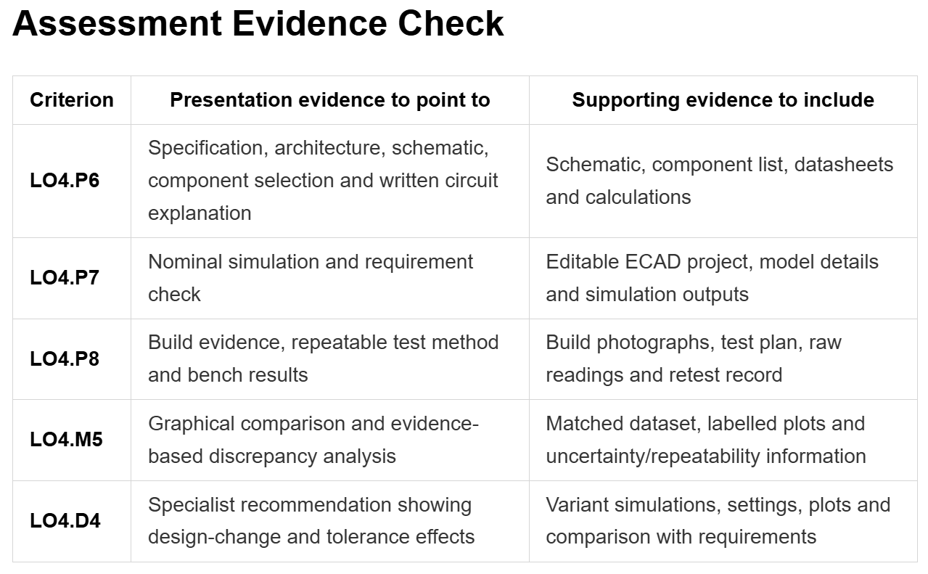

Slide 14

Q & A
Let’s discuss questions
as a team.

